Slide 1


Studies on Human Behaviour Methods and tools for data collection. Passive data: smartphones or other devices.
Mattia Zeni
University of Trento

Slide 2
Outline
Study human behaviour (15min)
Types of data for studying human behaviour? (15min)
Which types of sensor data? (15min)
Where to collect data from? (15min)
Laboratory setting vs in the wild concept? (15min)
How to install the i-Log application (15min)

Slide 3
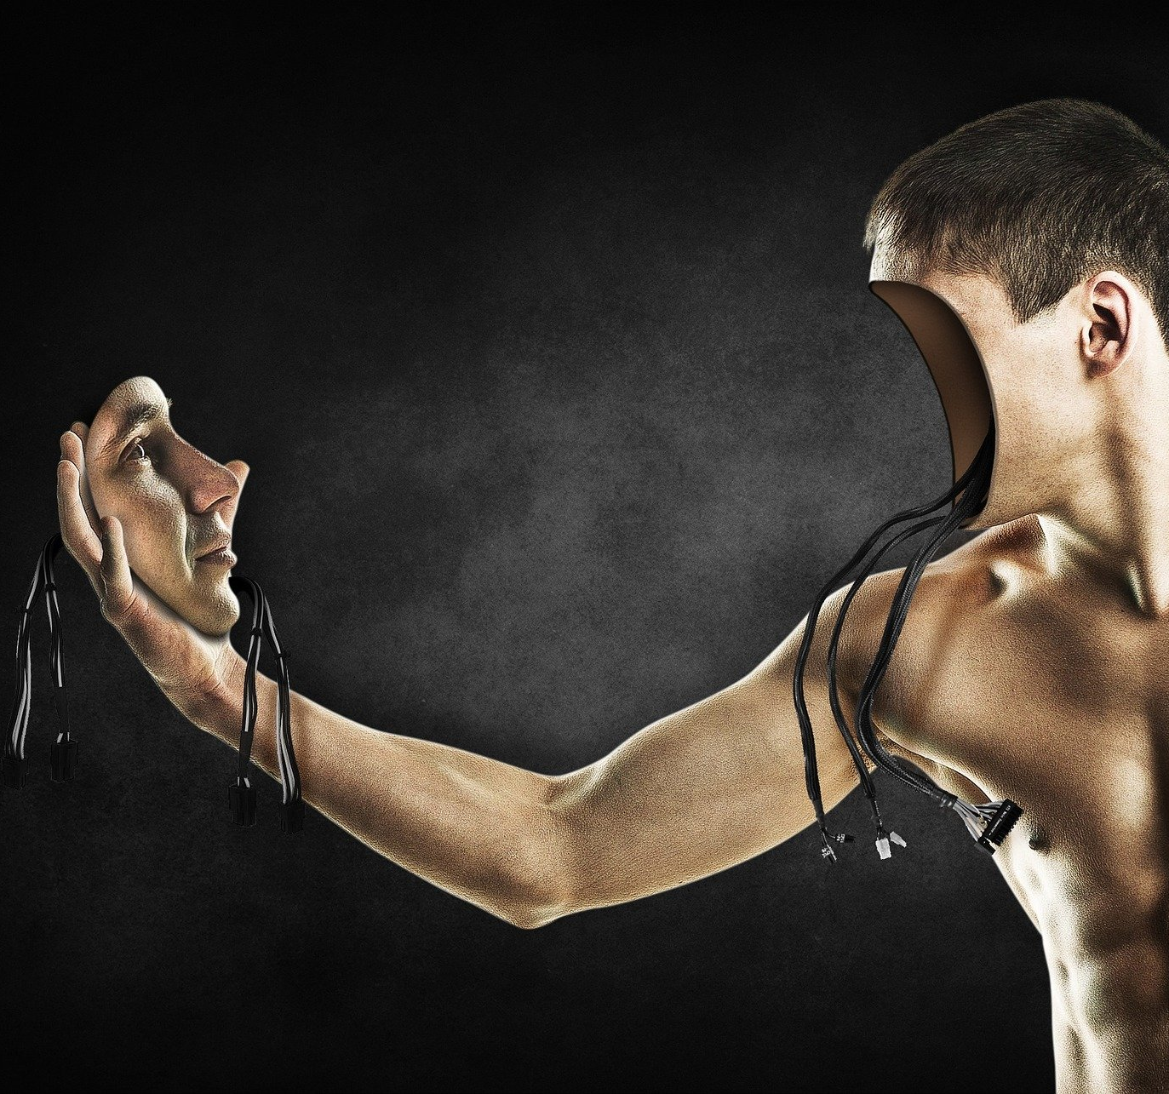
Study human behaviour

Slide 4
Objective – What do we want to achieve?
We want to study human behavior.
Let’s split this sentence into smaller elements. The goal it to arrive to a list of actionable items
Actionable = has value and leads to a result when it’s done
What is human behaviour?
What is the purpose of the study?
Which humans? All of them or?

Slide 5
What is human behaviour?
Human behaviour refers to the way humans act and interact. It is based on and influenced by several factors, such as genetic make-up, culture and individual values and attitudes.
Nature.com
People are very complex systems. We act based on our needs, habits and routines.
We don’t want to study everything about human behaviour.

Slide 6
What is human behaviour?
If you think about it, most of our actions can be described by four main components:
Activity (what)
Location (where)
Interactions with others (with whom)
Interactions with other objects (with what)
The same activity (going to work) has different instantiations for every one of us, considering those four elements. This is the contextual part.
Context is:
“…a theory of the world which encodes an individual’s subjective perspective about it…”
[Giunchiglia, 1993]. “Contextual reasoning”. In: Epistemologia, special issue on I Linguaggi e le Macchine 16, pp. 345–364

Slide 7
What is human behaviour?
We now have a characterization of human behaviour that can be measured, through it’s four components: activity, location, social, objects.
You can see that now it’s incredibly easier than before (but still absolutely hard) thinking about studying human behaviour.
The simplest solution would be to manually annotate those four dimensions.

Slide 8
What is the purpose of the study?
Why we want to study and understand how people act and interact?
What is the role of AI in all this? Automatize the process.
OPEN WORLD, IN THE WILD
Because we want to understand
Because we want to control
Because we want to support
Because we want to empower

Slide 9
Which humans?

Slide 10
What is the purpose of the study?
Components of human beahviour

Slide 11

Types of data for studying human behaviour

Slide 12
What do we want to achieve?
Time diaries
Video streams
Sensor streams
Health records

Slide 13

Where to collect data from?

Slide 14
Which devices can generate sensor data?

Slide 15
Sensor data about human behaviour
Sensor data is the output of a device that detects and responds to some type of input from the physical environment. The output may be used to provide information or input to another system or to guide a process.

Slide 16
Objective – Examples of sensor data

Slide 17
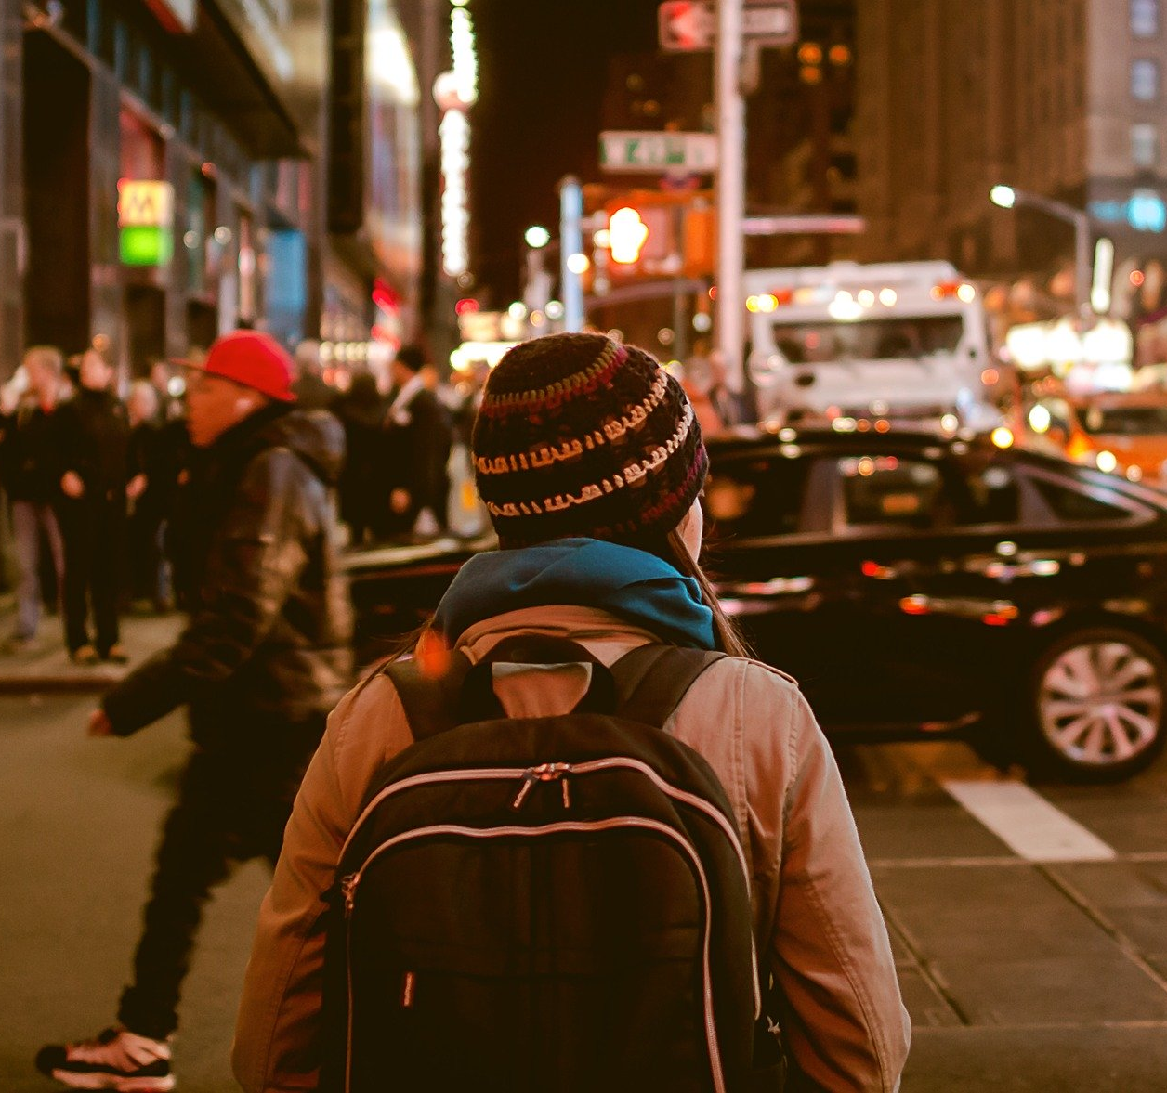
Laboratory setting or in the wild

Slide 18
Objective – Examples of sensor data

Slide 19
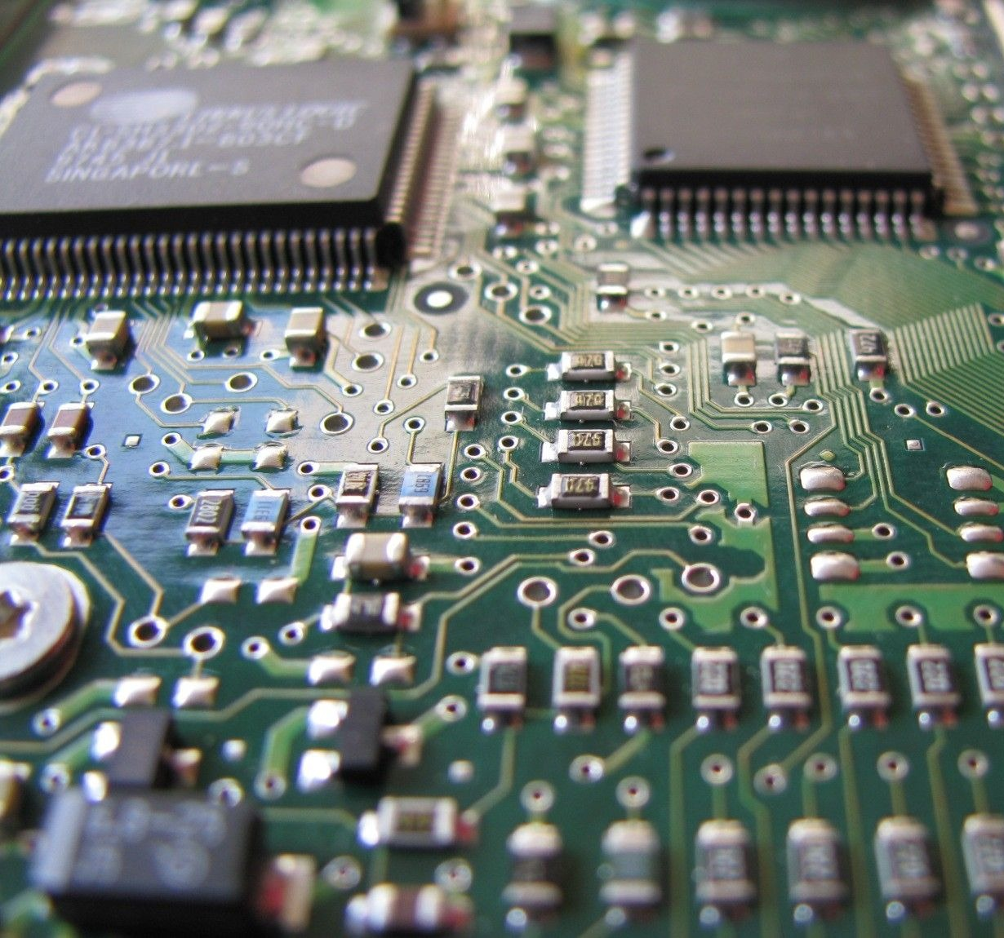
Which types of sensor data

Slide 20
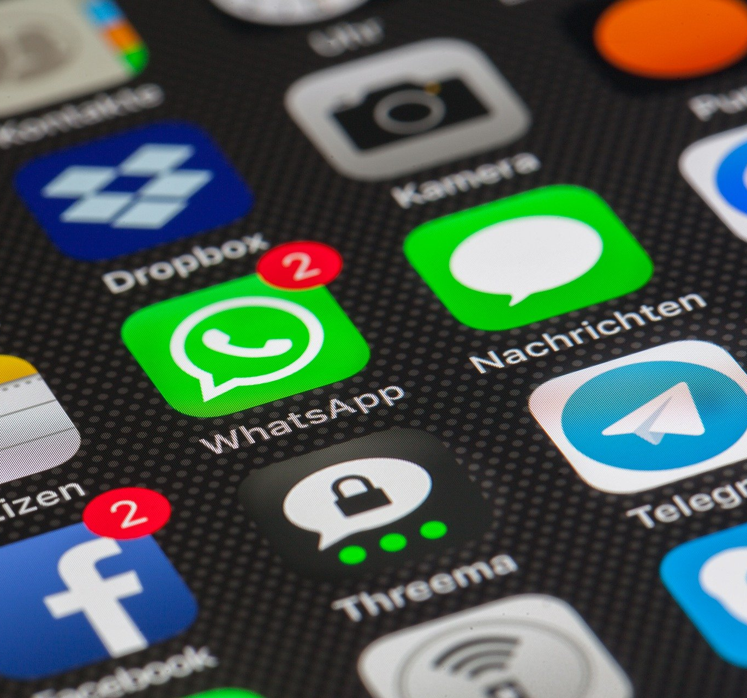
How to install the i-Log application

Slide 21
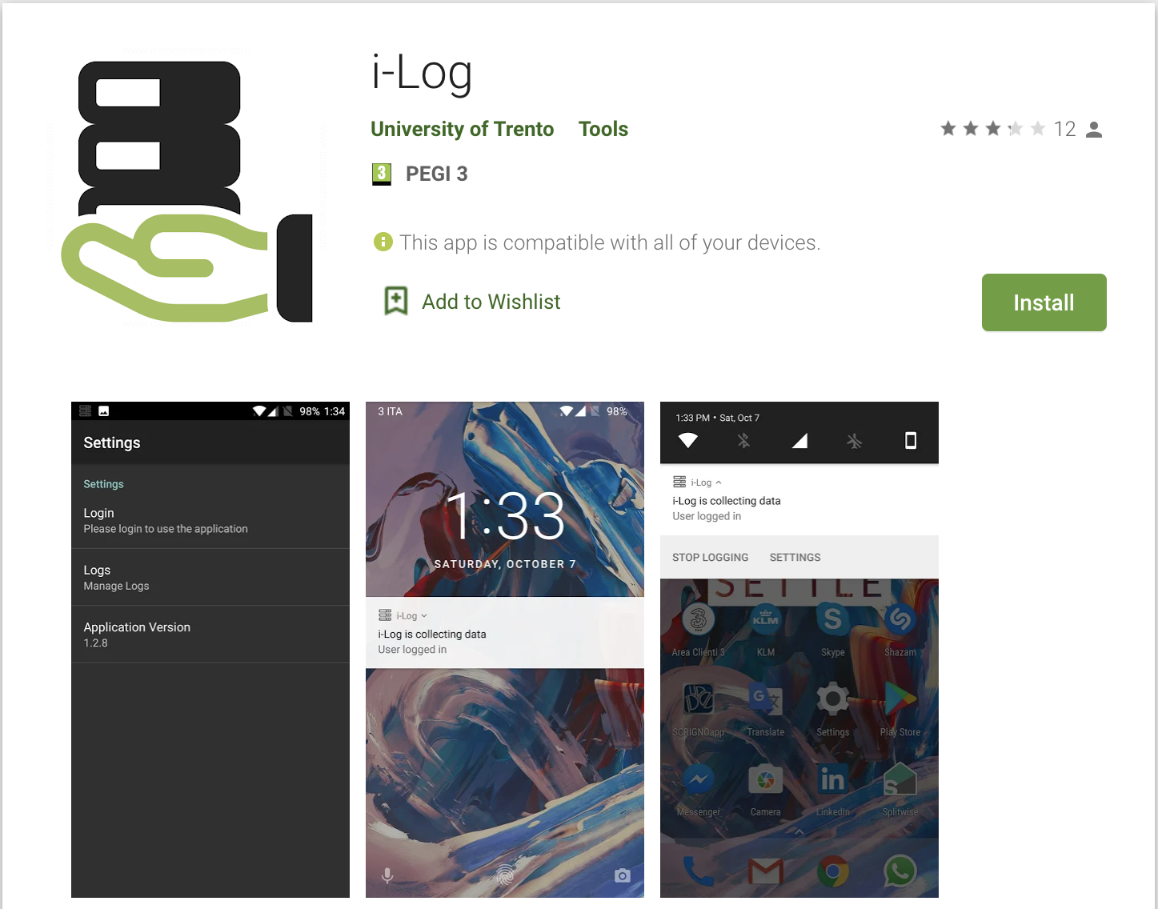
Requirements

Slide 22
PlayStore download

Slide 23
How the application works

Slide 24
Sensor data collection

Slide 25
Time diaries collection

Slide 26
Experiment setup

Slide 27
Experiment start

Slide 28
Experiment end

